Slide 1
Applied Ecosystem Chemistry
Linking ecological interactions to a century of environmental change
Megan L. Feddern

Slide 2
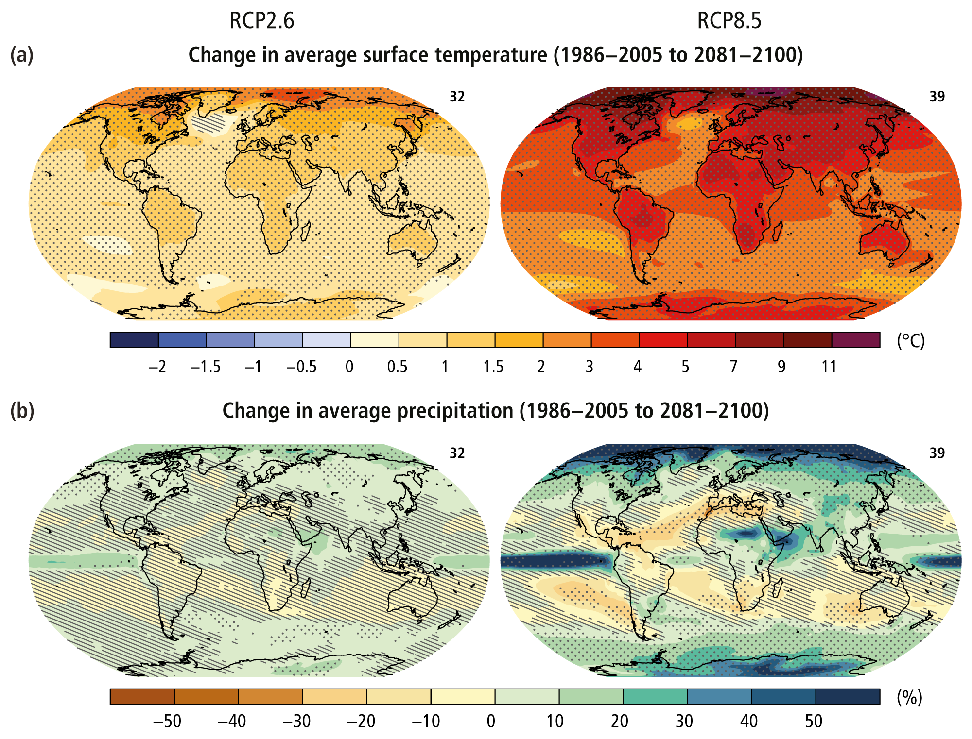

Slide 3
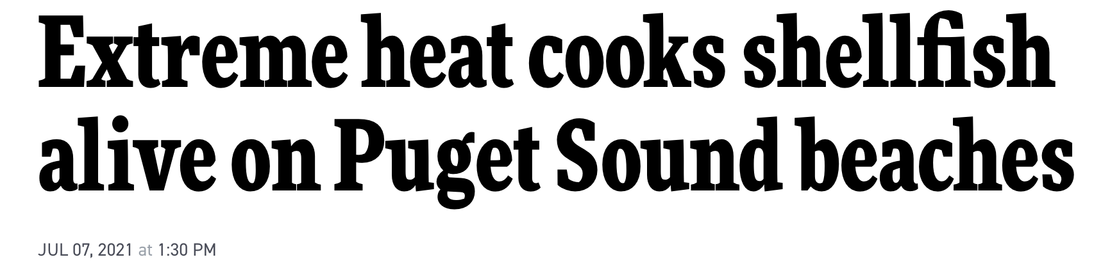
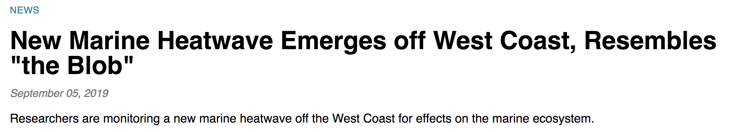
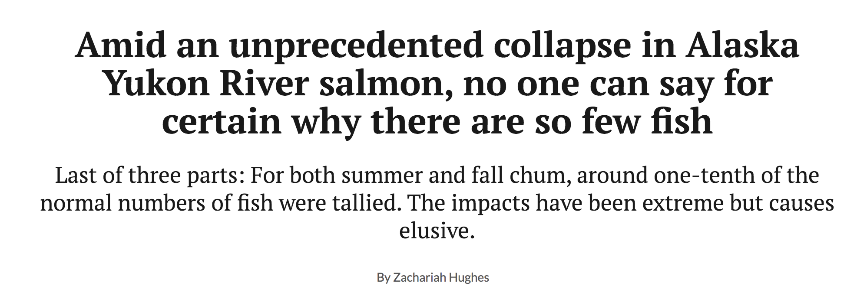
CREDIT: CHRIS BURNS / JAMESTOWN S'KLALLAM TRIBE

Slide 4
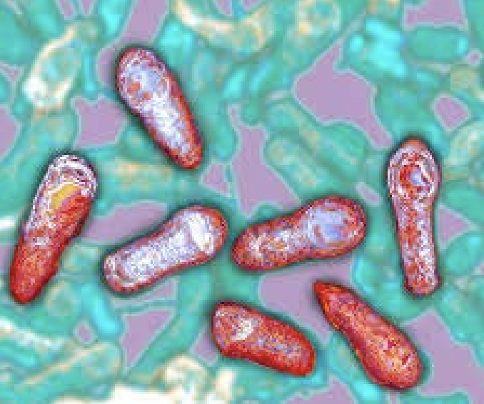
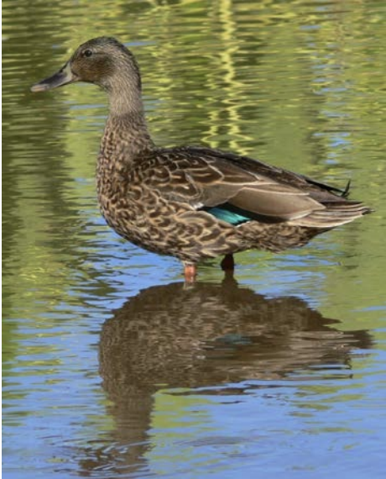
How do physical conditions alter food webs?
Endangered koloa maoli
(Hawaiian duck)
Hanalei National Wildlife Refuge
C. Malachowski
Notes:
Always been interested in how animals interact with their physical environment

Slide 5
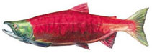

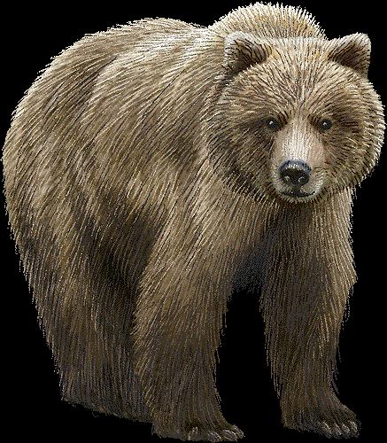
How do physical conditions alter food webs?
How do food webs interact with physical conditions?
“Simplified” Soil N Cycle
Soil
Organic
Matter
NH₄⁺
NO₃⁻
Denitrification
Transformation
Transformation
Leaching
Leaching
Notes:
Also interested in the feedback of how salmon influence their environment

Slide 6
How do food webs interact with physical conditions?
Soil Chemistry
Notes:
Also interested in the feedback of how salmon influence their environment

Slide 7
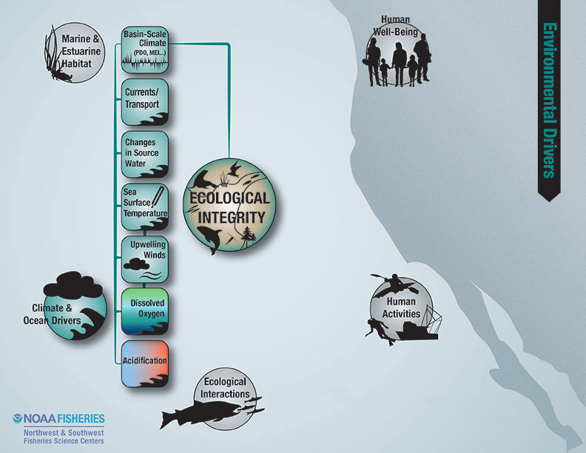
Understanding interactions: what physical conditions are ecologically meaningful?

Slide 8
Understanding change: what is ecologically meaningful?
Predator
Dissolved Nitrogen

Slide 9
Understanding change: what is ecologically meaningful?
Predator Interactions
Dissolved Nitrogen

Slide 10
Understanding change: temporal frame of reference

Slide 11
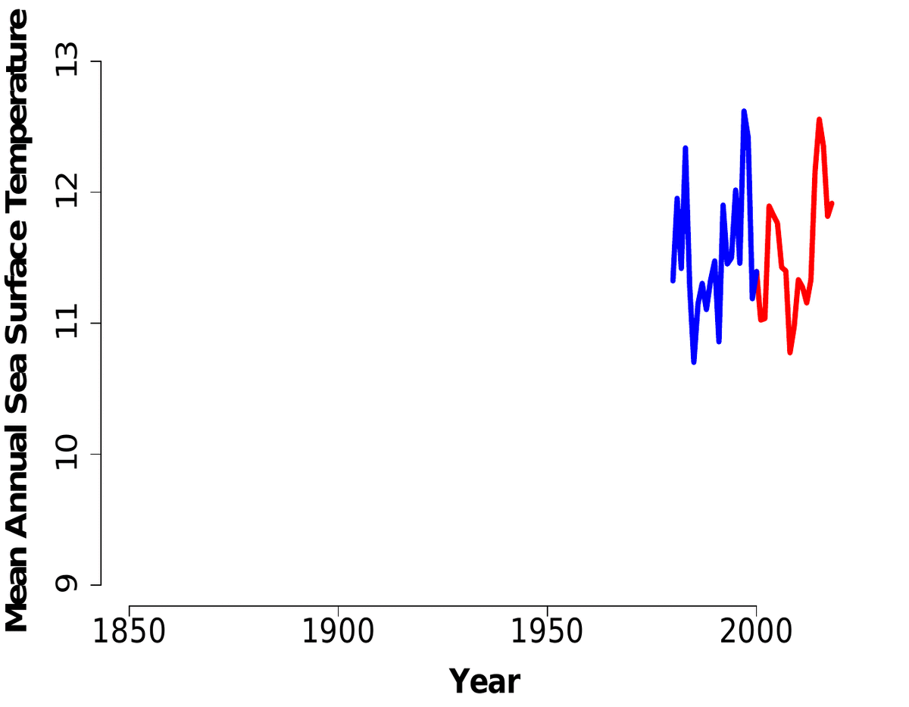
Physical Conditions
Resources
Primary Producers
Nutrients
NO₃⁻, NH₄⁺,
urea, Fe
Predator Interactions
Long Timescales
Available Prey

Slide 12
Overview
How does the environment impact primary production and resources utilized by northeast Pacific food webs?
Has harbor seal and Steller sea lions feed food web position changed in Alaska in recent decades?
How have changes in prey availability and the environment impacted where harbor seals feed in the food web in coastal Washington and the Salish Sea?

Slide 13
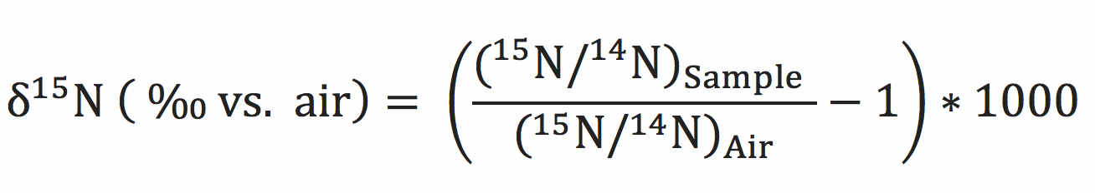
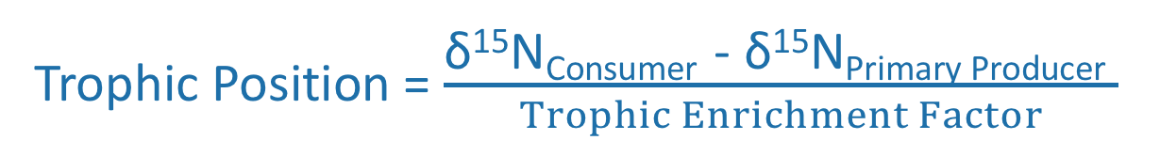


δ¹⁵N of phenylalnine
Trophic Position = $\frac{\text{δ}\text{15}\text{N}\text{Consumer}\text{ − }\text{δ}\text{15}\text{N}\text{Primary} \text{Producer} }{Trophic Enrichment Factor}$
$$\text{δ}\text{15}\text{N}\text{Phenylalanine}$$
Standard
$$\text{δ}\text{15}\text{N}\text{Primary} \text{Producer}$$

Slide 14
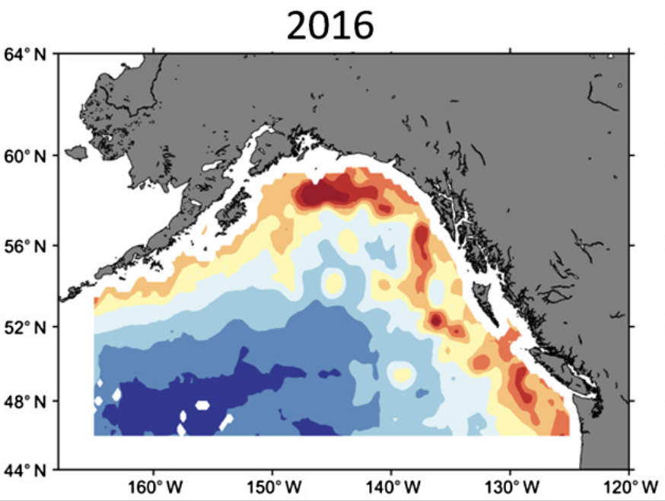
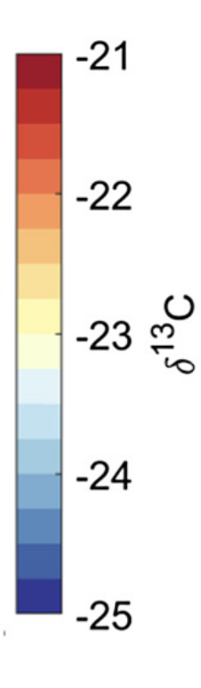


δ¹³C to calculate movement/foraging location and carbon sources
$$\text{More} \text{productive}$$
Sources
Terrestrial
Marine derived
C3 plants
C4 plants
$$\text{Less} \text{productive}$$
Espinasse et al. 2019. Global Ecology and Biogeography, Volume: 29, Issue: 2, Pages: 246-261, First published: 12 November 2019, DOI: (10.1111/geb.13022)

Slide 16
2. Challenges in Ecological Stable Isotope Applications

Slide 17
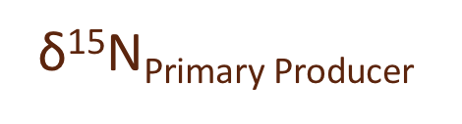


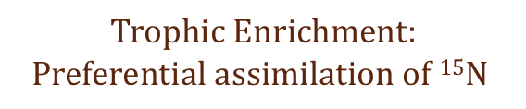
Variations in biogeochemistry: nitrogen resources
$$\text{δ}\text{15}\text{N}\text{Consumer}$$
Trophic Position = $\frac{\text{δ}\text{15}\text{N}\text{Consumer}\text{ − }\text{δ}\text{15}\text{N}\text{Primary} \text{Producer} }{Trophic Enrichment Factor}$
$$Trophic Enrichment:$$
$$Preferential assimilation of 15N$$
Nitrogen Sources (NO₃⁻, NH₄⁺, urea)
Isotope composition of N
Light availability, taxa
$$\text{δ}\text{15}\text{N}\text{Primary} \text{Producer}$$

Slide 18
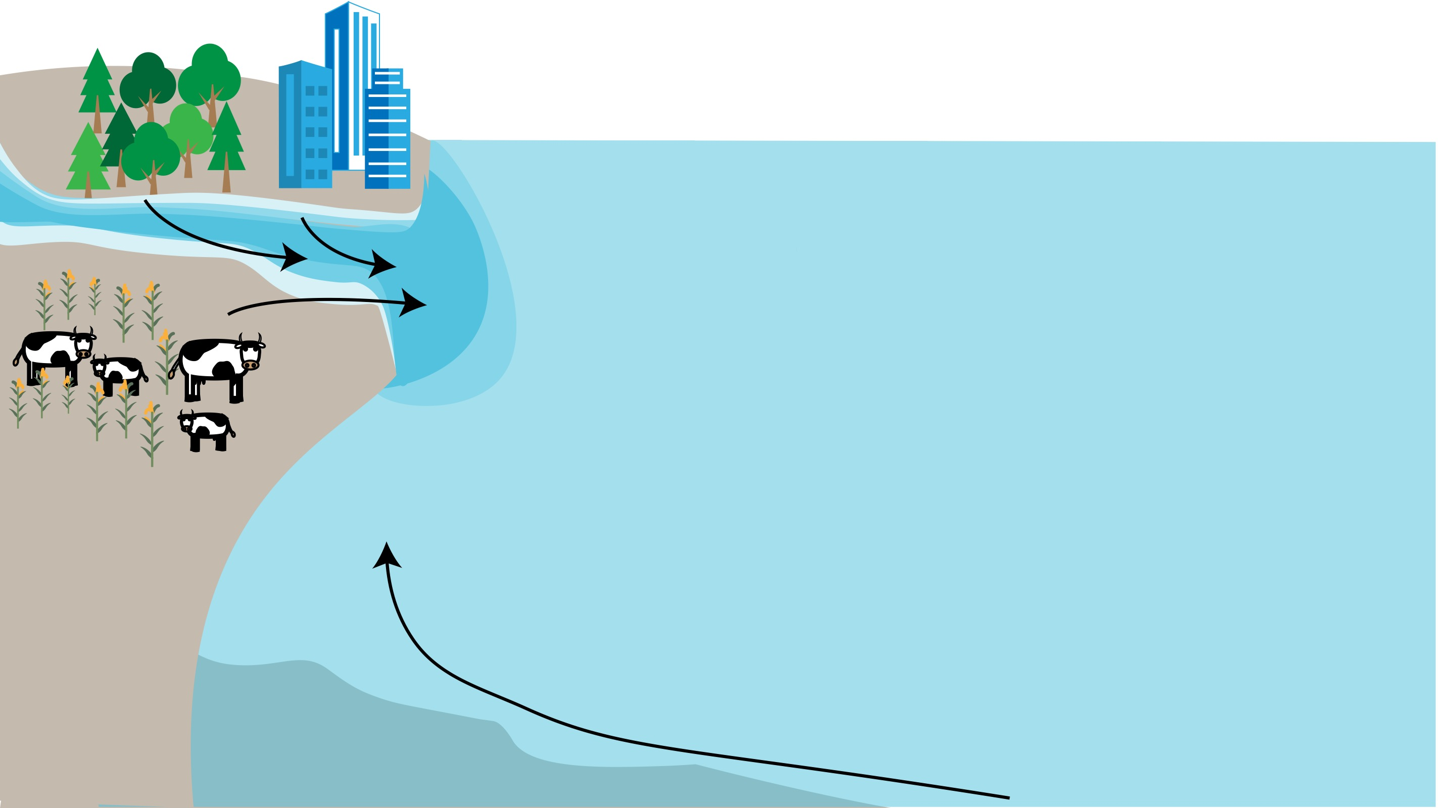
Discharge
NO₃⁻, NH₄⁺,
urea, Fe
Upwelling
NO₃⁻

Slide 19
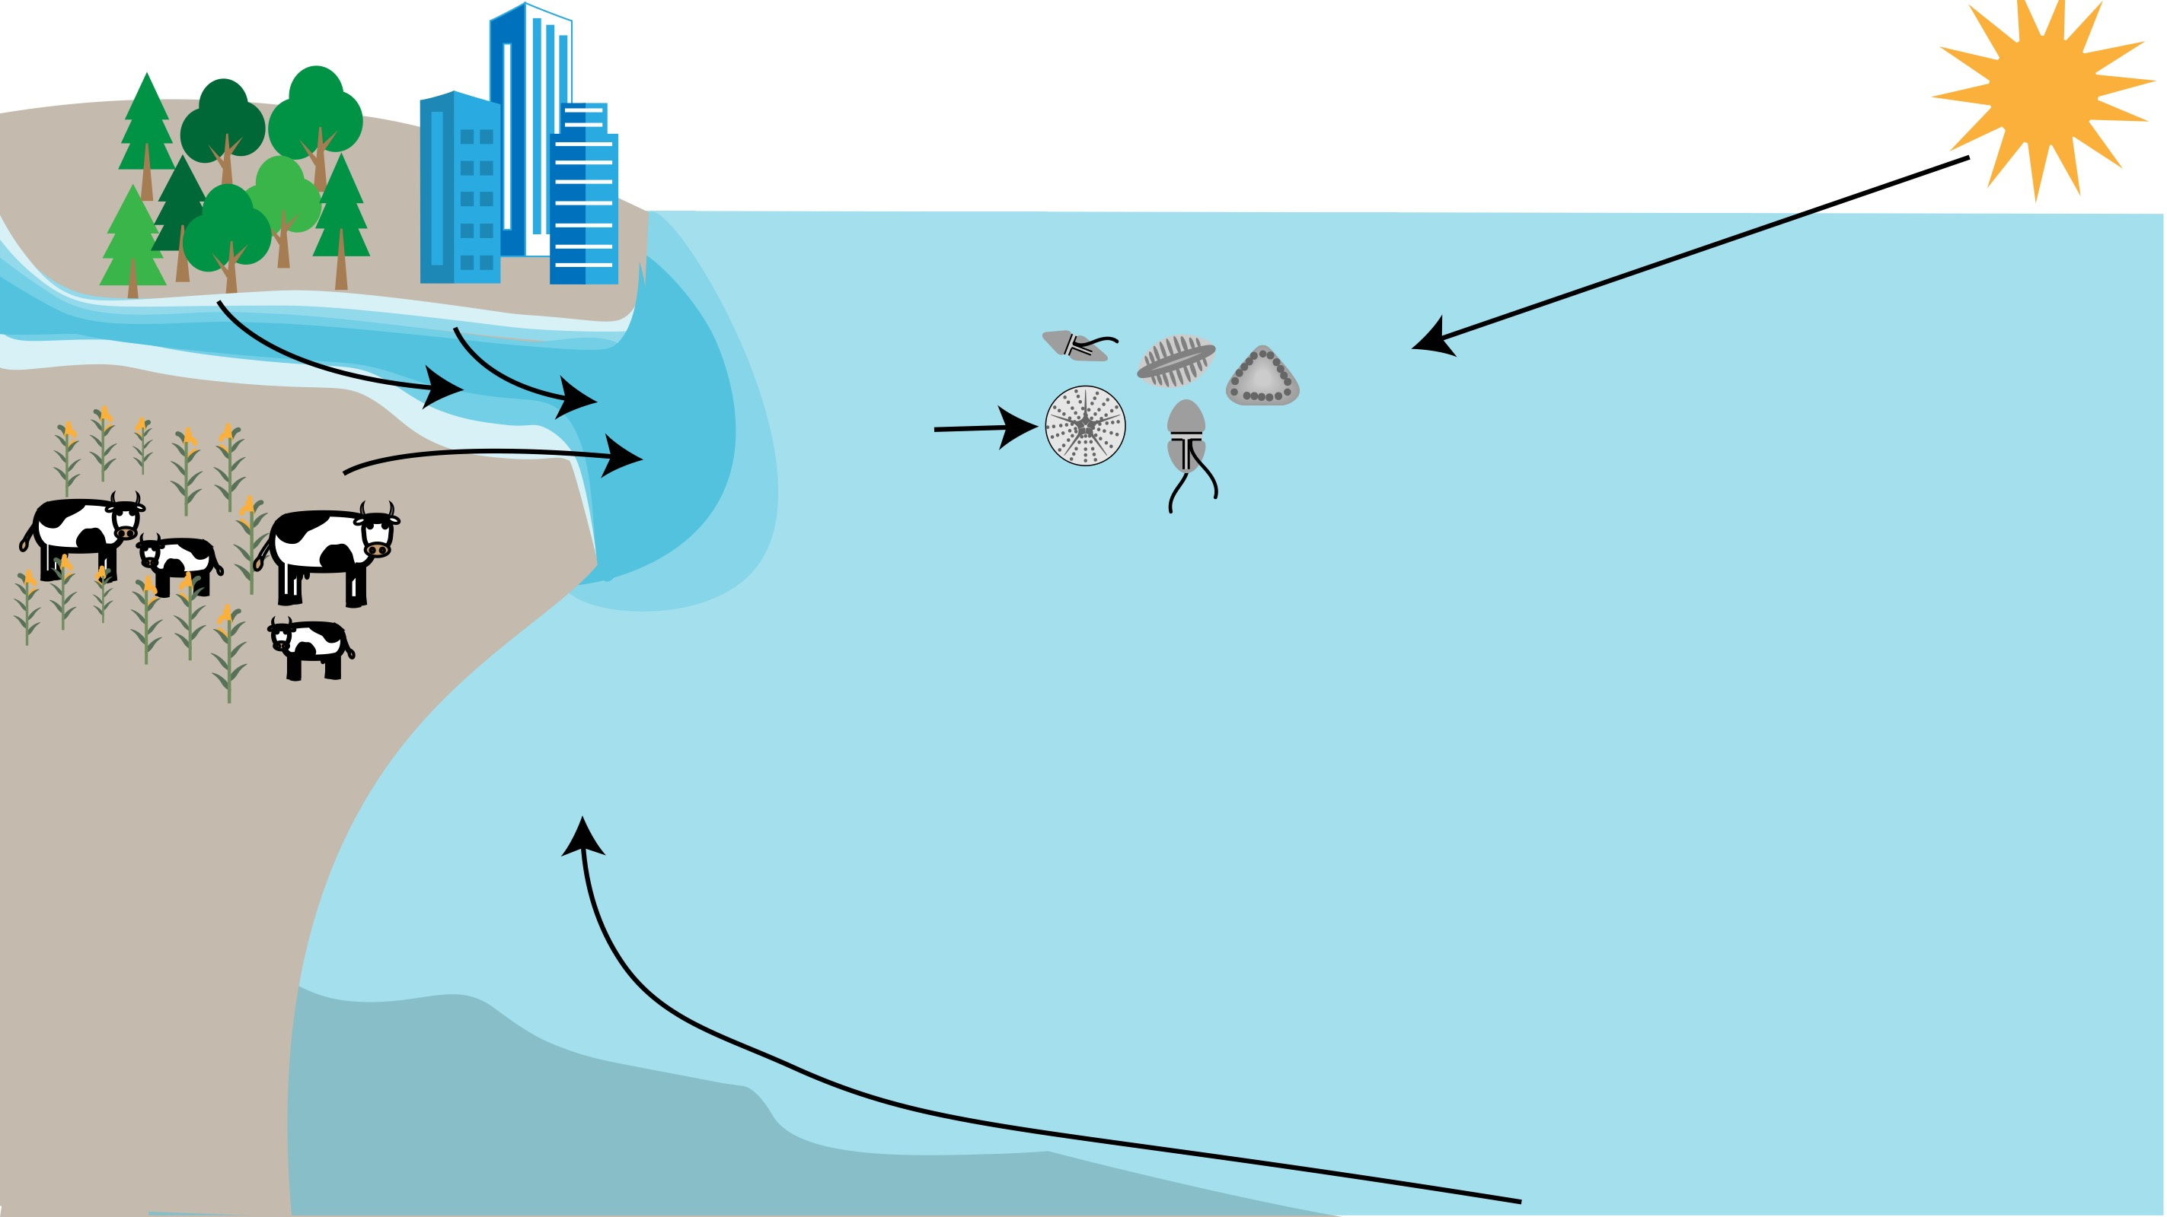
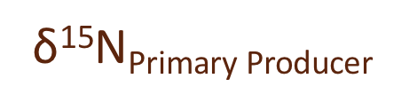
Sea Surface Temperature
Discharge
NO₃⁻, NH₄⁺,
urea, Fe
$$\text{δ}\text{15}\text{N}\text{Primary} \text{Producer}$$
Upwelling
NO₃⁻

Slide 20
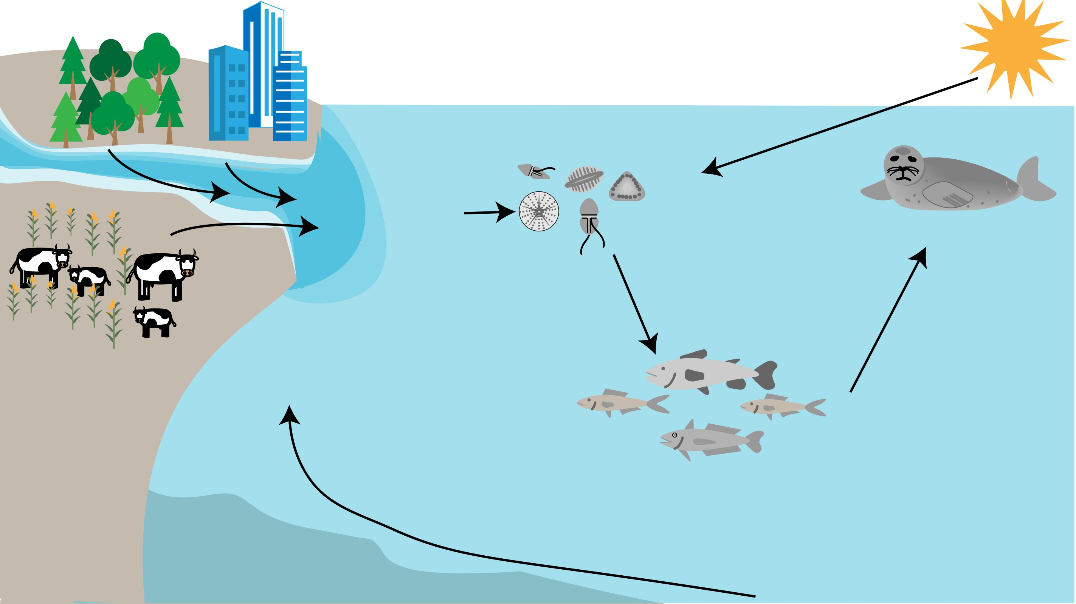
Sea Surface Temperature
Freshwater Discharge
NO₃⁻, NH₄⁺,
urea, Fe
Upwelling
NO₃⁻

Slide 21
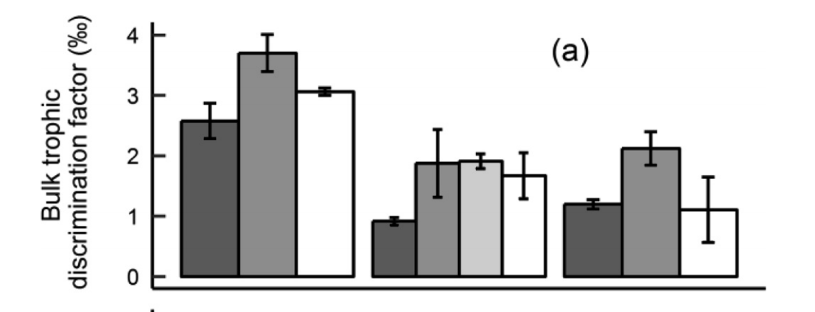
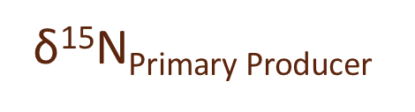


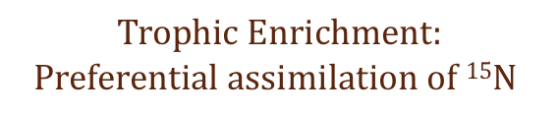
Variations in physiology: trophic enrichment
$$\text{δ}\text{15}\text{N}\text{Consumer}$$
Minnow
Zebrafish
Diet Quality
Growth
Disease
Tissue you sample
Guppy
$$Trophic Enrichment:$$
$$Preferential assimilation of 15N$$
Shrimp
Perch
Swordfish
Blanke et al. 2017
$$\text{δ}\text{15}\text{N}\text{Primary} \text{Producer}$$
Trophic Position = $\frac{\text{δ}\text{15}\text{N}\text{Consumer}\text{ − }\text{δ}\text{15}\text{N}\text{Primary} \text{Producer} }{Trophic Enrichment Factor}$
3.4‰

Slide 22
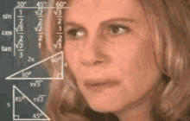
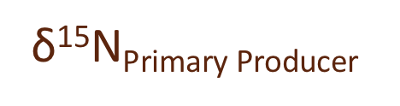
Variations in physiology: tissue turnover
What about prey switching???
What about movement???
Day 10: Eat Different Food
Day 45: Migrates
$$\text{δ}\text{15}\text{N}\text{Primary} \text{Producer}$$
Day 0: Eat Food
Day 5: Blood
Day 20: Liver
Day 80: Muscle

Slide 23
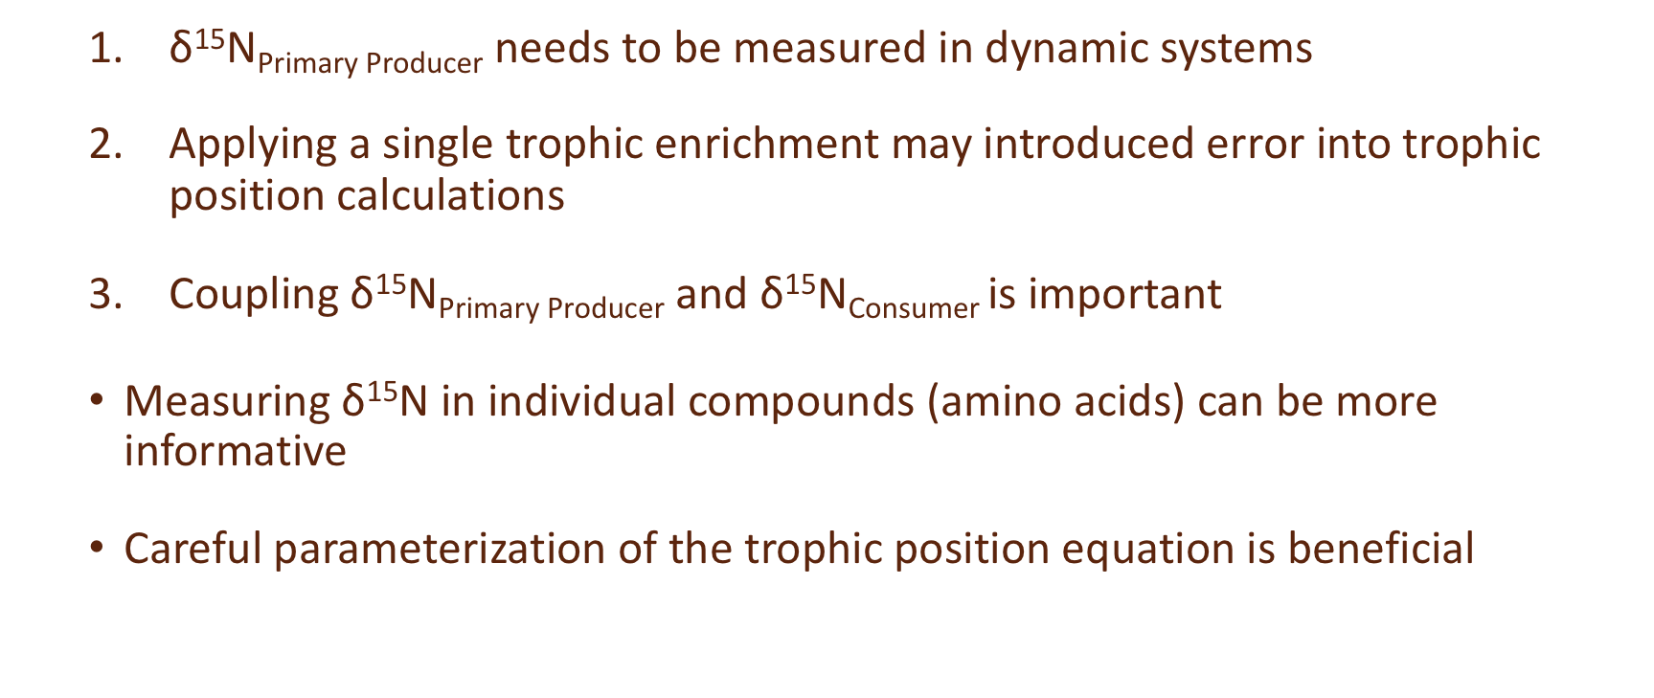
In Summary
$\text{δ}\text{15}\text{N}\text{Primary} \text{Producer}$needs to be measured in dynamic systems
Applying a single trophic enrichment may introduced error into trophic position calculations
Coupling $\text{δ}\text{15}\text{N}\text{Primary} \text{Producer}$and $\text{δ}\text{15}\text{N}\text{Consumer}$ is important
Measuring $\text{δ}\text{15}\text{N}$ in individual compounds (amino acids) can be more informative
Careful parameterization of the trophic position equation is beneficial

Slide 24
3. Parameterizing harbor seal trophic position equations

Slide 25
Scaling to Food Webs: Source Amino Acids
δ¹⁵N of phenylalanine
Eliminates trophic enrichment
Directly measures baseline from consumer tissue
Baseline is metabolically coupled with consumer
Conserved
Conserved
Source Amino Acids
δ¹⁵N of phenylalanine

Slide 26
Limited migration, high site fidelity
Are not utilizing resources in different locations
Generalists integrate over multiple resource pathways
5 - 10 km from haul out sites and at depths < 200 m
Are not susceptible to integrating nearshore vs. offshore δ¹³C gradients
Controlled feeding studies
Minimal trophic enrichment
Optimal consumer for stable isotope interpretation
Pacific Salmon
Hake
Herring

Slide 27
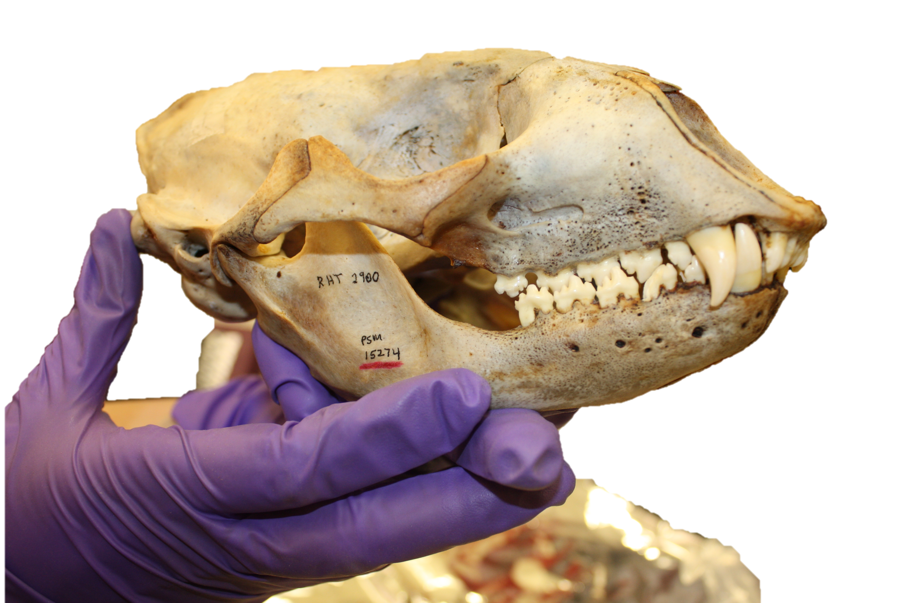
δ¹⁵N_{Phe}
+ 9 trophic amino acids

Slide 28
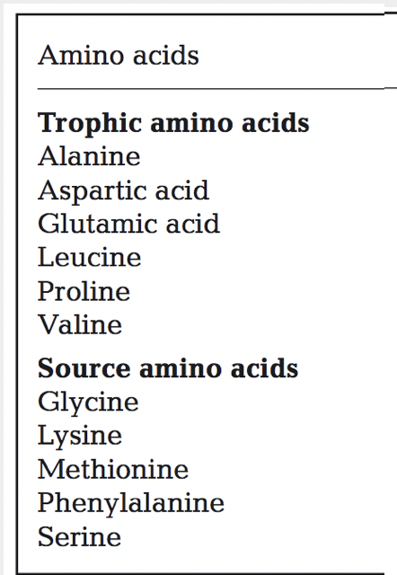

Parameterizing the trophic position equation: Amino Acids
Trophic Position = $\frac{\text{δ}\text{15}\text{N}\text{Consumer}\text{ − }\text{δ}\text{15}\text{N}\text{Primary} \text{Producer} }{Trophic Enrichment Factor}$
Glutamic Acid
Phenyalanine
Trophic Position = $\frac{\text{δ}\text{15}\text{N}\text{Trophic}\text{, }\text{Amino} \text{Acid}\text{ − }\text{δ}\text{15}\text{N}\text{Source}\text{, }\text{Amino} \text{Acid}\text{ − }β}{Trophic Enrichment Factor}$ +1
Fractionation of primary production

Slide 29
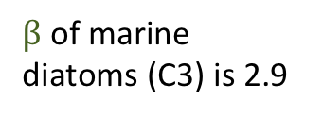
Addressing Trophic Enrichment Factor Variability: Primary Production
Trophic Position = $\frac{\text{δ}\text{15}\text{N}\text{Consumer}\text{ − }\text{δ}\text{15}\text{N}\text{Primary} \text{Producer} }{Trophic Enrichment Factor}$
$β$ of marine diatoms (C3) is 2.9
Trophic Position = $\frac{\text{δ}\text{15}\text{N}\text{Trophic}\text{, }\text{Amino} \text{Acid}\text{ − }\text{δ}\text{15}\text{N}\text{Source}\text{, }\text{Amino} \text{Acid}\text{ − }β}{Trophic Enrichment Factor}$ +1
7.6 “classic”
BUT...Germain et al. 2013 found harbor seal trophic enrichment factor is 4.3???
AND...Feddern et al. 2021 found C4 (seagrasses) plants contribute to WA food webs ($β$ = -8.7)

Slide 30
How should we parameterize trophic position?
Diatoms (C3)
Seagrasses (C4)
Weighted C3 + C4
Harbor Seal TEF
“Classic” TEF
Average across multiple taxa
Trophic Amino Acid | β_{Diatoms} Nielsen et al. 2015 | β_{Seagrass} Vander Zanden et al. 2013 | β_{Weighted} This study | TEF_{Harbor Seal} Germain et al. 2013 | TEF_{Plankton} Chikaraishi et al. 2009 | TEF_{Average} Nielsen et al. 2015
Glutamic acid (Glu) | 2.9 | -8.7 | -3.9 | 3.4 | 7.6 | 6.6
Alanine (Ala) | 2.8 | -8.0 | -3.6 | 2.5 | 5.6 | 6.8
Aspartic Acid (Asp) | 1.8 | -7.3 | -4.2 | 3.5 | 5.4* Nielsen et al. 2015 | 5.4*
Valine (Val) | 3.4 | -6.8 | -2.6 | 7.5 | 4.2 | 4.6
Proline (Pro) | 2.7 | -7.7* Not reported used average of other AAs |  | 5.5 | 5.0 | 5.0
Which beta should we use?
How should we incorporate different trophic enrichment factors?
Which amino acids should we use?

Slide 31
Effect of different Trophic Enrichment Factors of Trophic Position

Slide 32
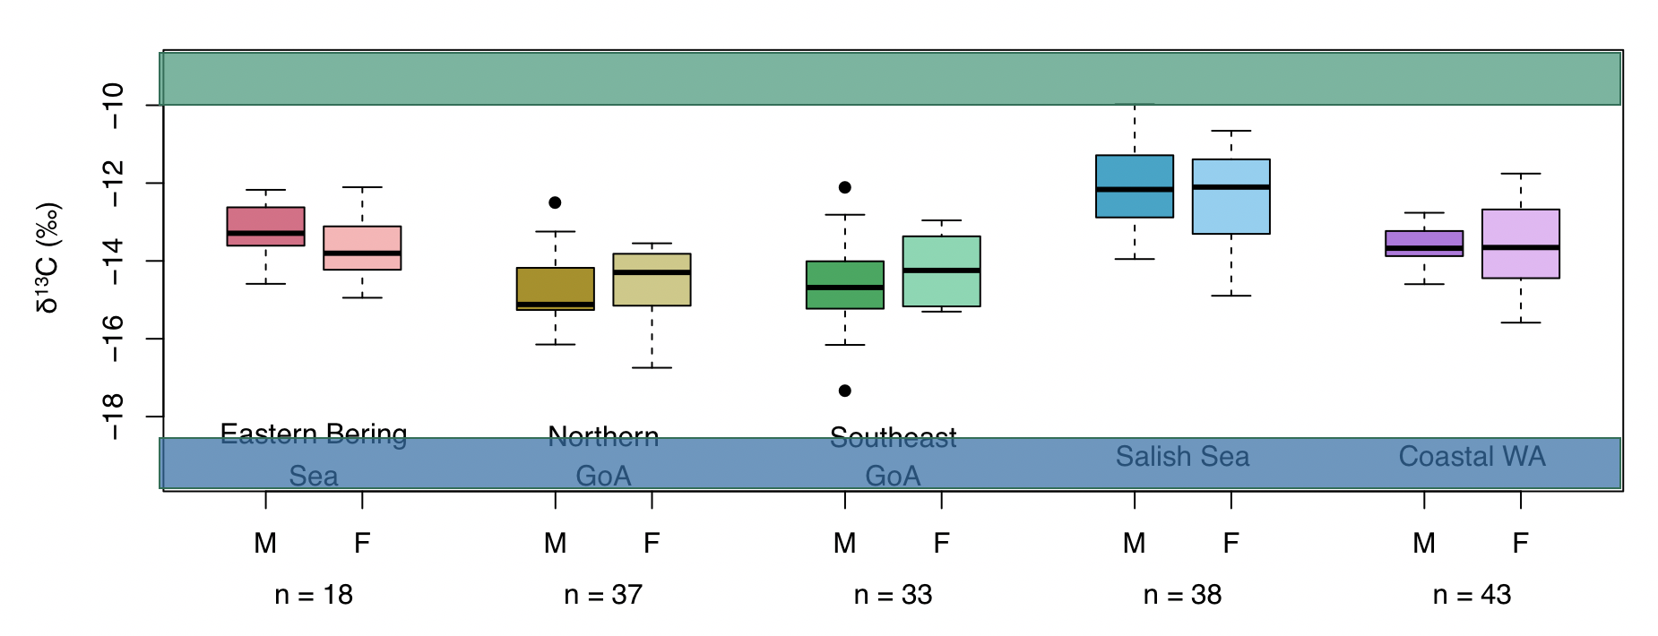
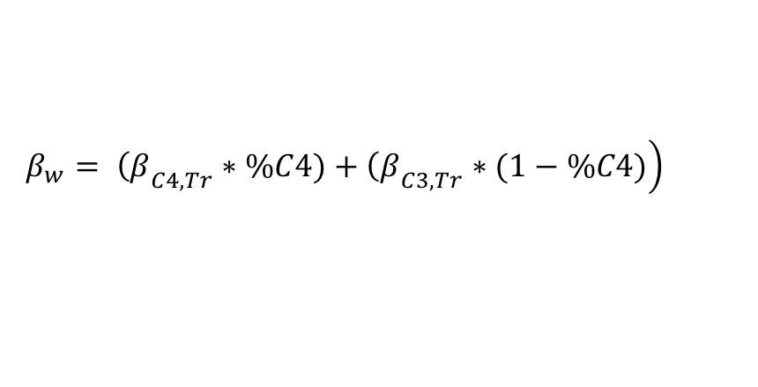
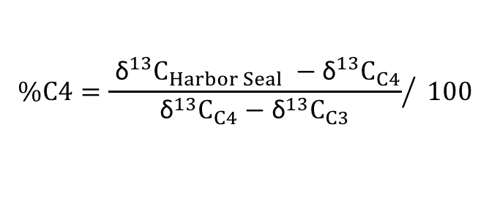
C4 Plants
C3 Plants
$$\%C4={\frac{ {\text{δ}}^{13}C_{Harbor Seal} −{\text{δ}}^{13}C_{C4}}{{\text{δ}}^{13}C_{C4}−{\text{δ}}^{13}C_{C3}}}/ 100$$
$$\left.β_{w}= {\left(β\right.}_{C4, Tr}∗\%C4)+{\left(β\right.}_{C3, Tr}∗(1−\%C4)\right)$$
Feddern et al. 2021

Slide 33
Consideration for a weighted Beta

Slide 34
Which beta should we use?
How should we incorporate different trophic enrichment factors?
Which amino acids should we use?
What about tissue turnover?
Trophic Amino Acid | β_{Diatoms} Nielsen et al. 2015 | β_{Seagrass} Vander Zanden et al. 2013 | β_{Weighted} This study | TEF_{Harbor Seal} Germain et al. 2013 | TEF_{Plankton} Chikaraishi et al. 2009 | TEF_{Average} Nielsen et al. 2015
Glutamic acid (Glu) | 2.9 | -8.7 | -3.9 | 3.4 | 7.6 | 6.6
Alanine (Ala) | 2.8 | -8.0 | -3.6 | 2.5 | 5.6 | 6.8
Aspartic Acid (Asp) | 1.8 | -7.3 | -4.2 | 3.5 | 5.4* Nielsen et al. 2015 | 5.4*
Valine (Val) | 3.4 | -6.8 | -2.6 | 7.5 | 4.2 | 4.6
Proline (Pro) | 2.7 | -7.7* Not reported used average of other AAs |  | 5.5 | 5.0 | 5.0

Slide 35
Applying temporal lag: tissue turnover
Year-0
Ecological Condition
1976
1977
Lag 1 = Tissue Turnover, physiological delay

Slide 36
4. How does harbor seal trophic ecology respond to environmental change and prey availability?

Slide 37
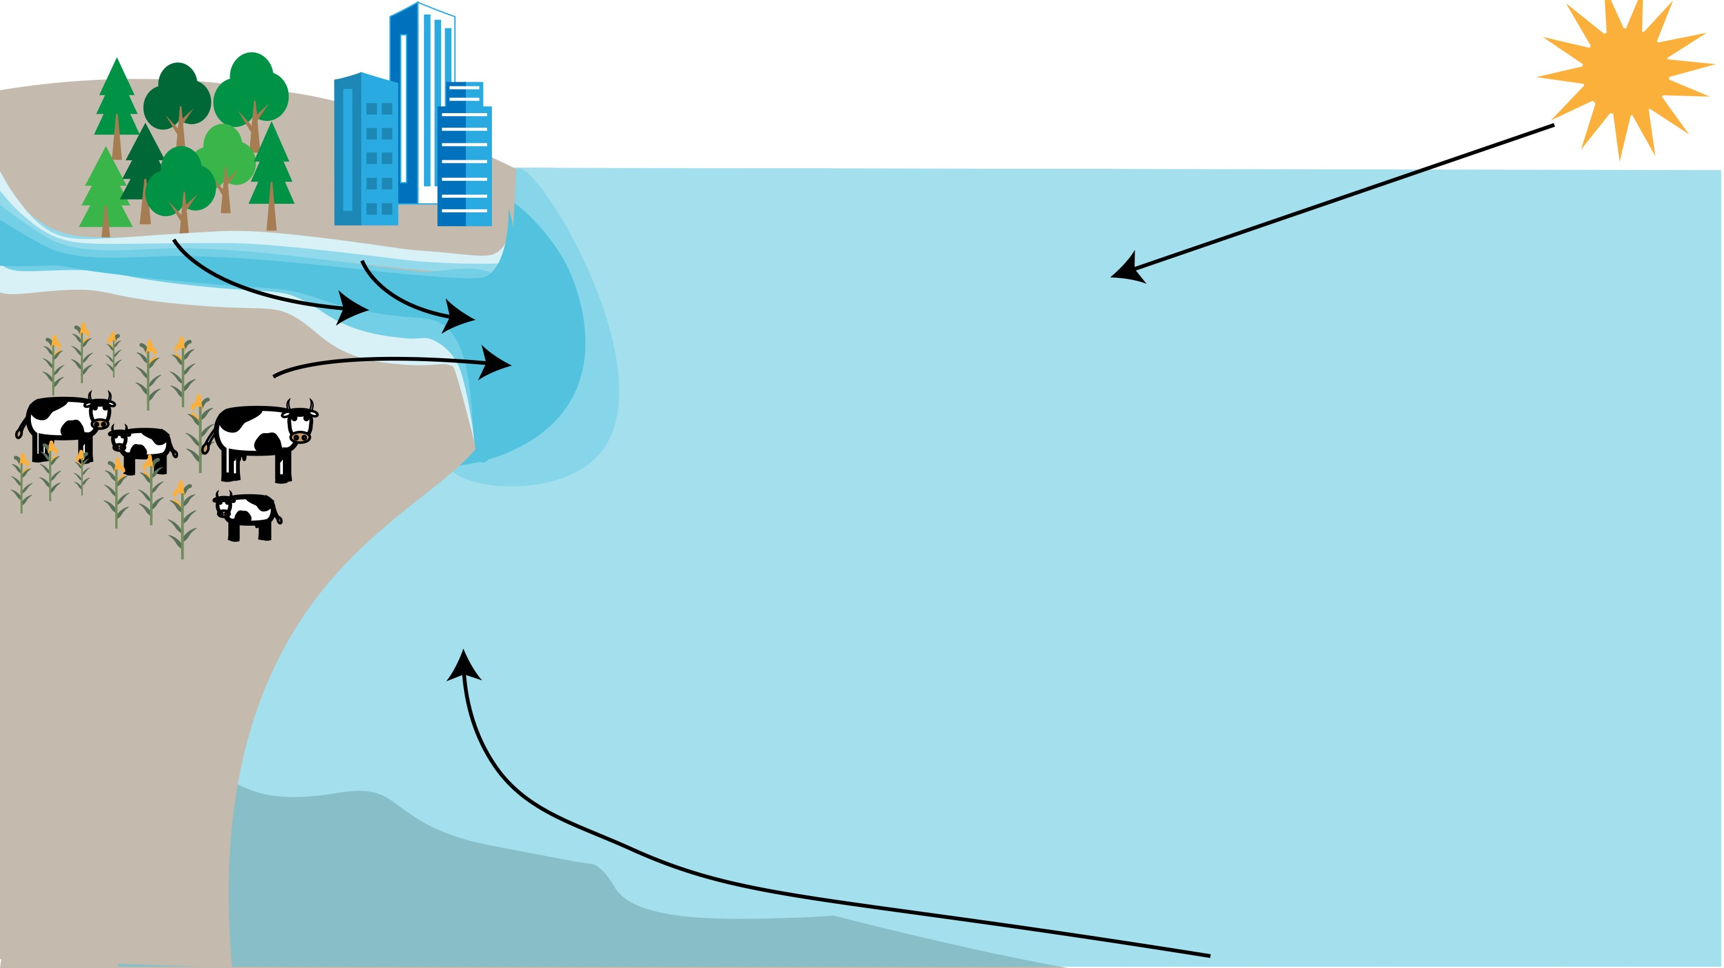
Environmental Covariates
Discharge
Columbia River
Fraser River
Sea Surface Temperature
Mean Summer
Climate Regime
Pacific Decadal Oscillation (PDO)
North Pacific Gyre Oscillation (NPGO)
Multivariate ENSO Index (MEI)
Upwelling
Coastal Upwelling (Spring, Summer)
NO₃⁻

Slide 38
Prey Covariates
Pacific Salmon
Chinook escapements
Coho escapements
Wild Chinook smolt production
Hatchery Chinook smolt production
Hake
Spawning biomass
Herring
Spawning biomass

Slide 39
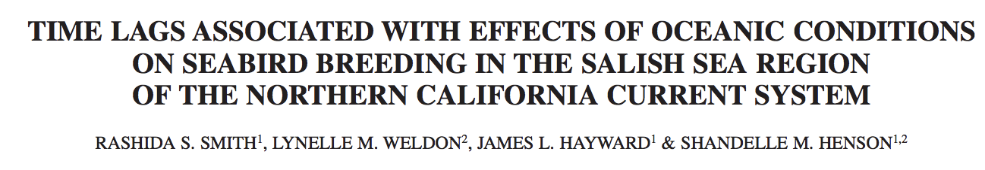
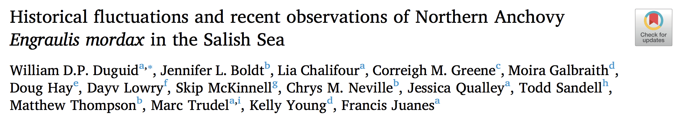
Modelling food web assimilated resources through time, with the environment

Slide 40
Applying temporal lags: delay in ecological response
Year-2
Year-1
Year-0
Ecological
Delay
Ecological
Delay
Physiological Delay
1974
1975
1976
1977
Lag 1 = Tissue Turnover, physiological delay
Lag 2 = ecological response 1 year delay
Lag 3 = ecological response 2 year delay

Slide 41
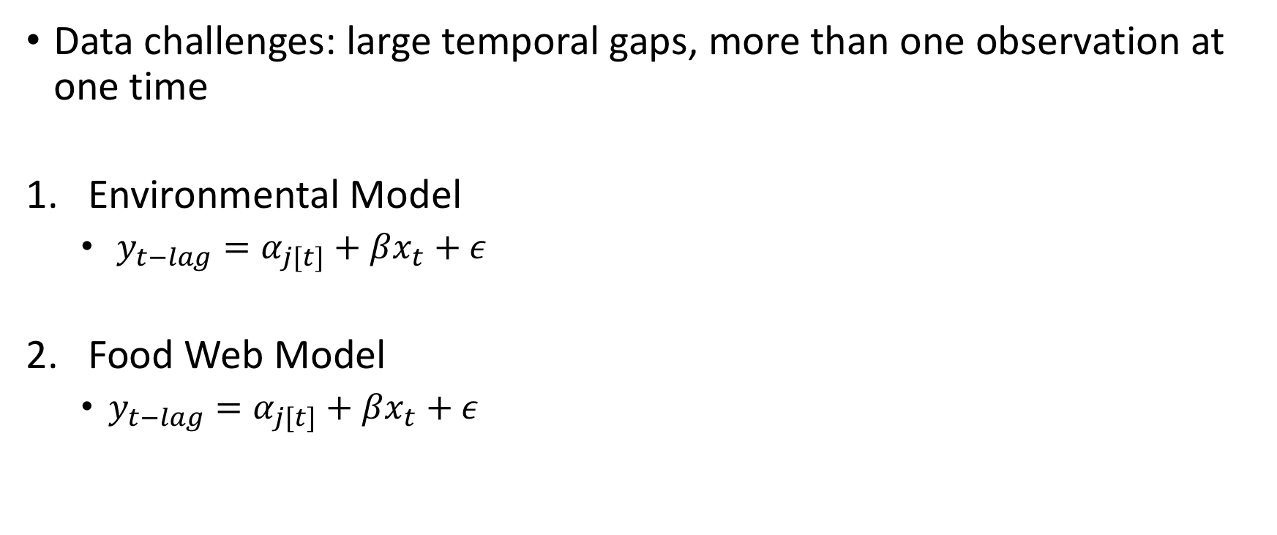
Modelling food web assimilated resources through time, with the environment
Data challenges: large temporal gaps, more than one observation at one time
Environmental Model
$y_{t−lag}=α_{j[t]}+βx_{t}+ε$
Food Web Model
$y_{t−lag}=α_{j[t]}+βx_{t}+ε$
Lag: 1, 2, 3 year lag
Random effect j is amino acid (glutamic acid, alanine, proline, valine)
Environmental Covariates
Prey Availability Covariates
Amino Acid

Slide 42
Coefficient Estimate
Random
Best Environmental Model
Physiological & 2-year Ecological Delay
Physiological & 1-year Ecological Delay
Physiological Delay Only
Covariate

Slide 43
Coefficient Estimate
Covariate
Physiological & 2-year Ecological Delay
Physiological & 1-year Ecological Delay
Physiological Delay Only

Slide 44
Chinook smolts in the previous 2 years appear to be better predictors of what is available to predators than current escapements
Physiological &
2-year Ecological Delay
Physiological & 1-year Ecological Delay
Physiological Delay
Only

Slide 45
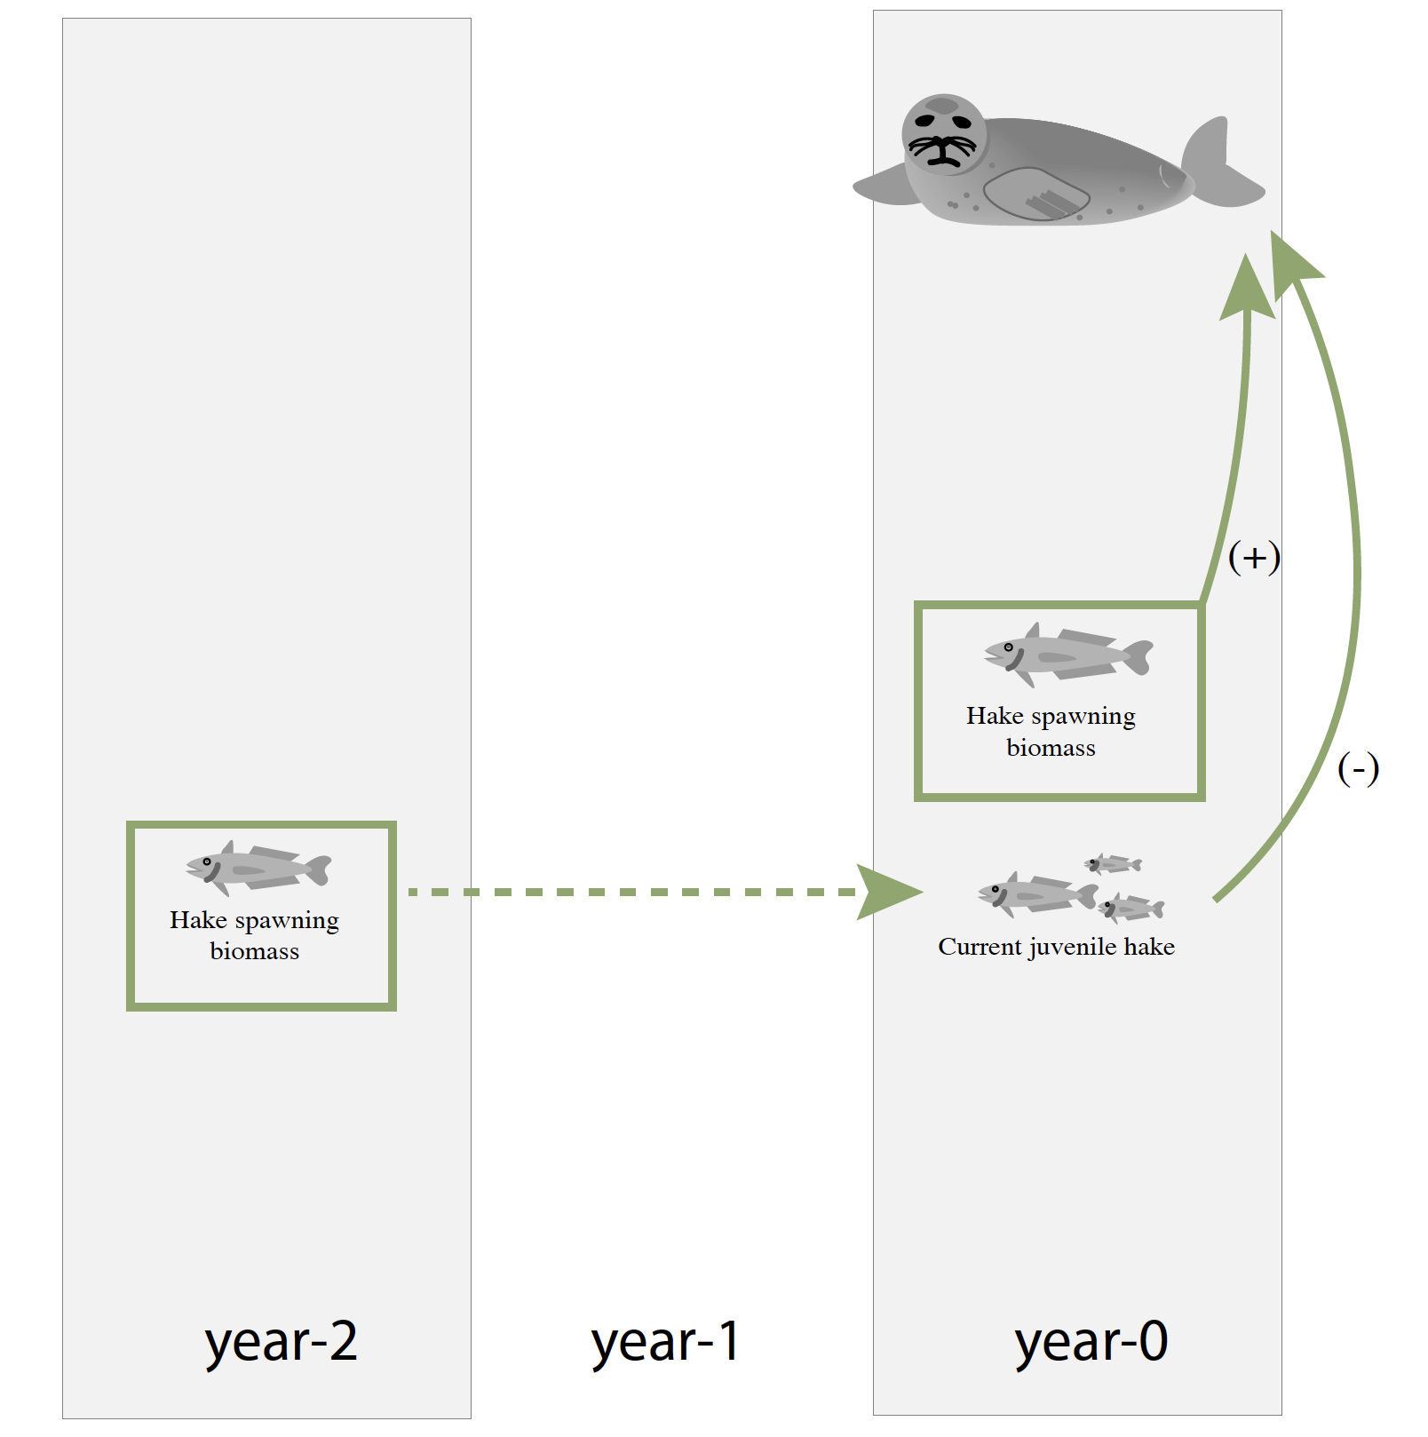
Both juvenile and adult hake influence harbor seal trophic ecology
Physiological &
2-year Ecological Delay
Physiological & 1-year Ecological Delay
Physiological Delay
Only

Slide 46
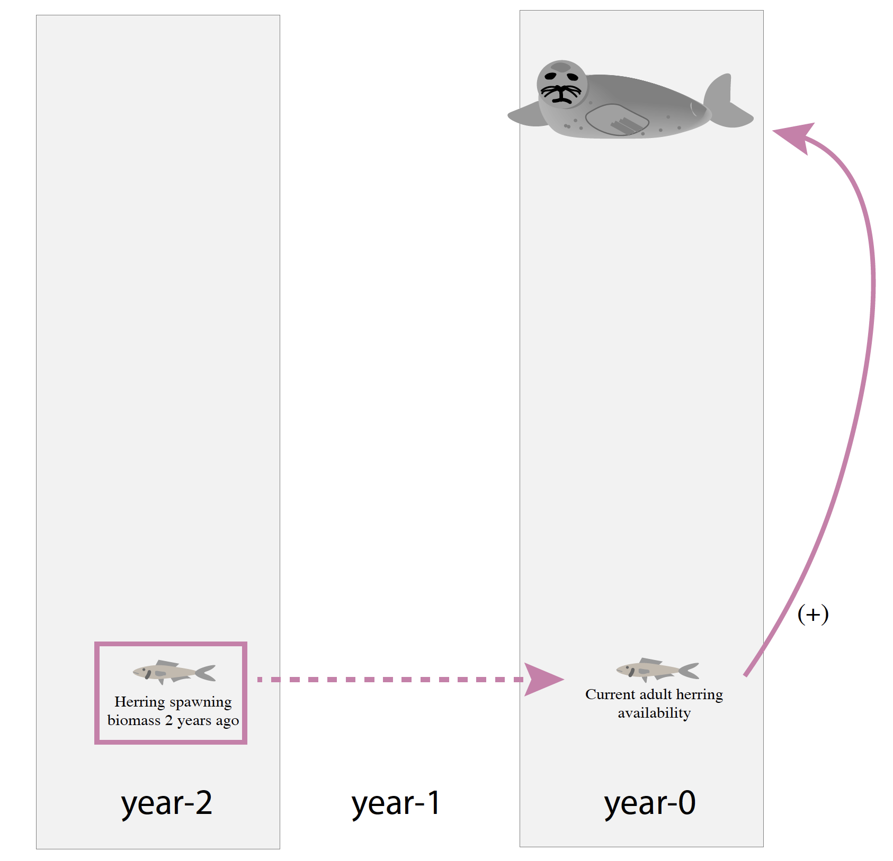
Herring spawning biomass in previous years has a bigger effect on current harbor seal trophic ecology than current spawning biomass
Physiological &
2-year Ecological Delay
Physiological & 1-year Ecological Delay
Physiological Delay
Only

Slide 47
Summary
Careful decision of parameterization can lead to more informative analyses
Including lags for delayed ecological responses and tissue turnover is important
Prey covariates that don’t represent availability to predators may miss important relationships

Slide 48





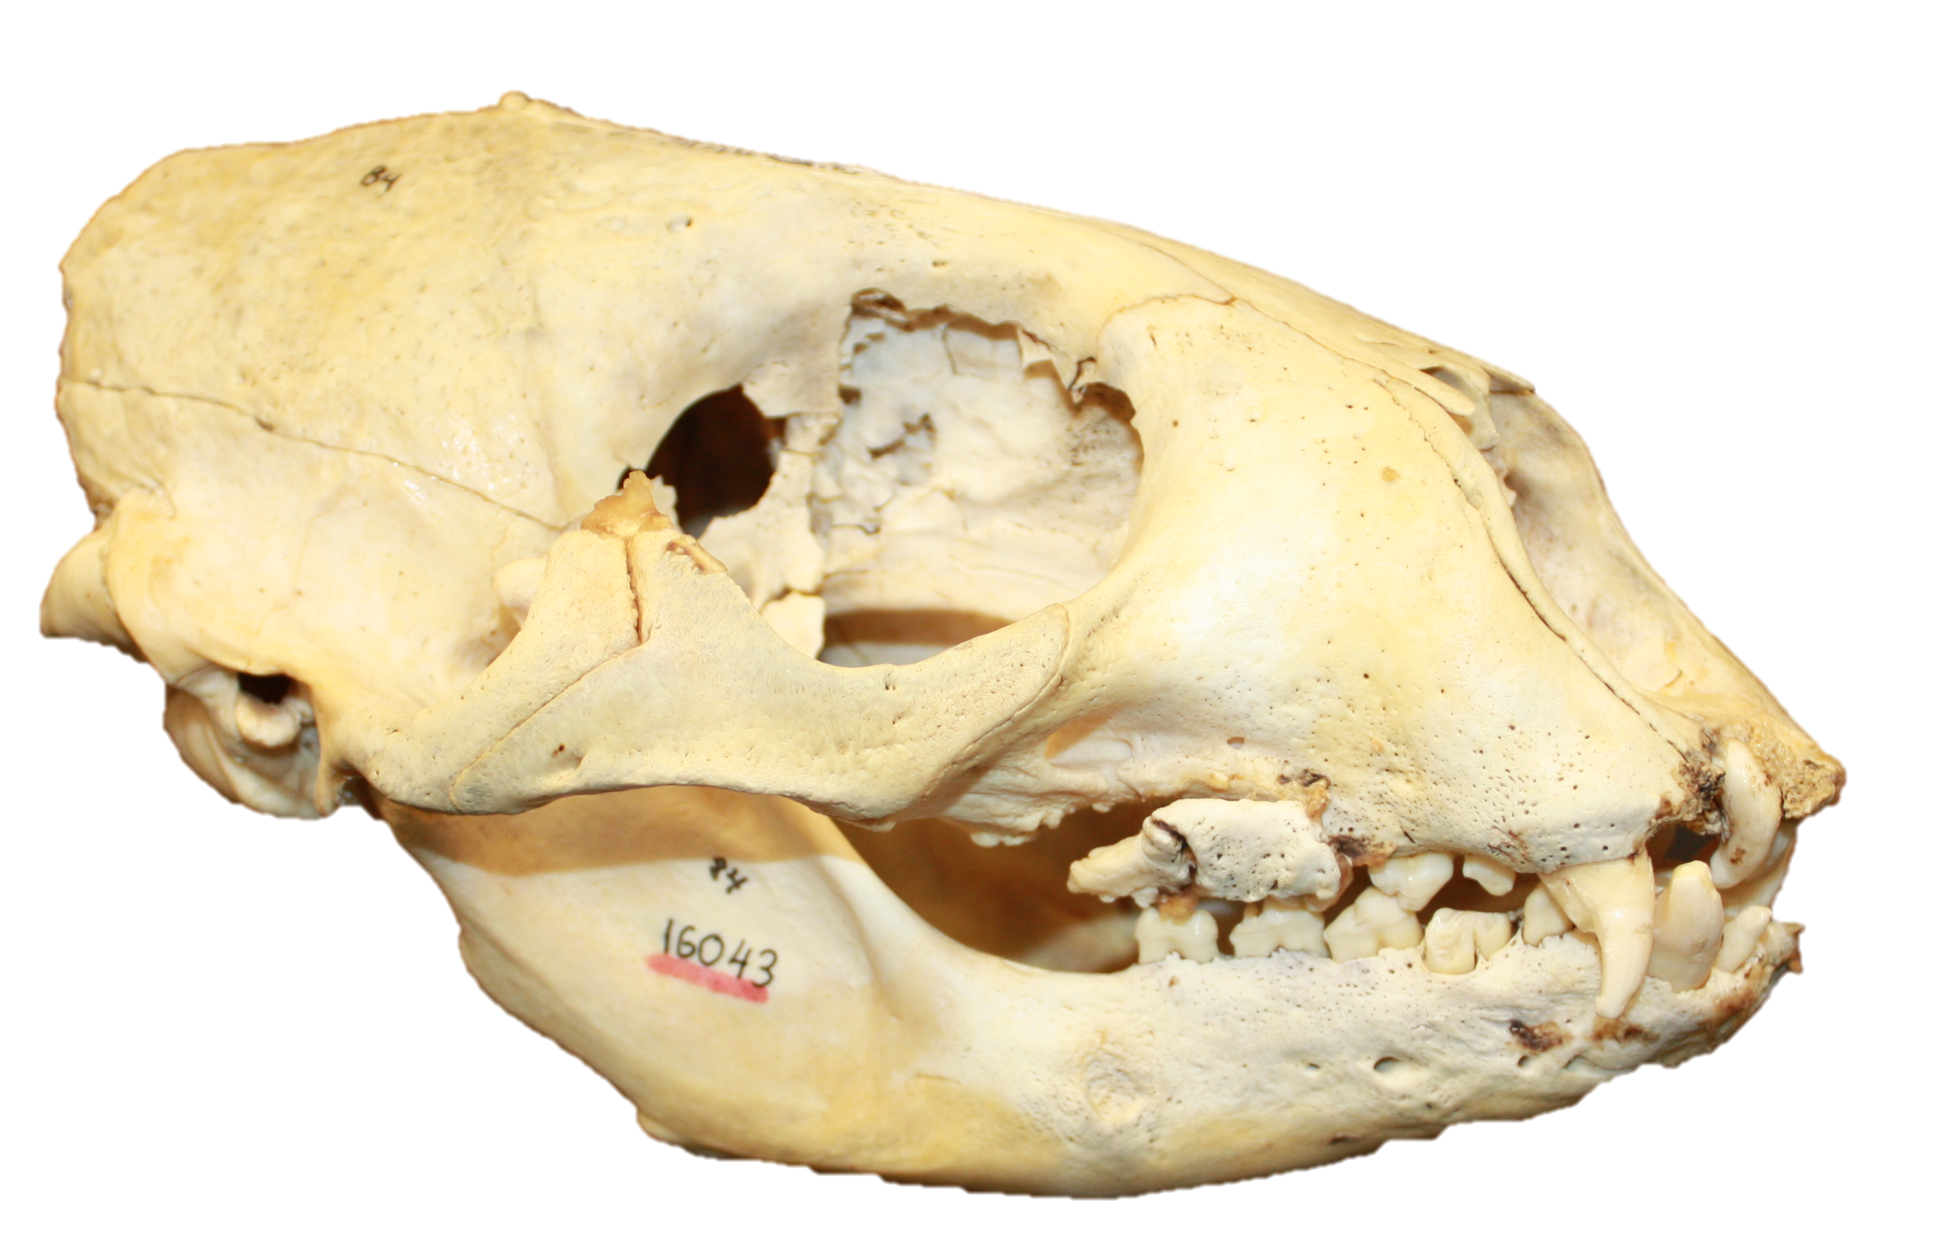


Collaborators and Acknowledgements

Slide 50
How does the environment impact resource utilization by coastal marine food webs?

Slide 51
Challenges of Scale
NO₃⁻, NH₄⁺,
urea
2. We can measure primary producers directly
1. We can measure resources directly
Availability ≠ Utilization

Slide 52
Utilizing Chemical Tracers
δ¹³C
Community Composition
Cellular Growth
[CO₂]
Additive
&
Subtractive
δ¹⁵N
Nitrogen Sources
Isotope composition of N
Large scale indicators

Slide 53
δ¹⁵N_{Phe}
δ¹³C

Slide 54
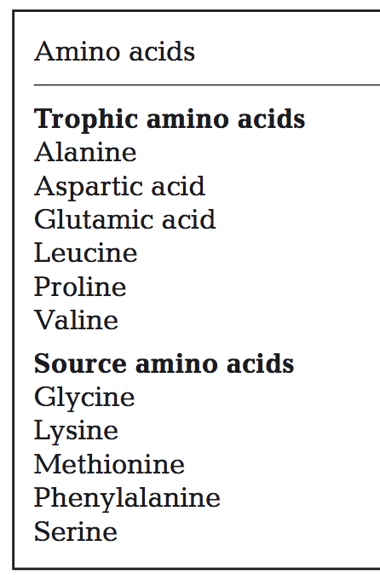
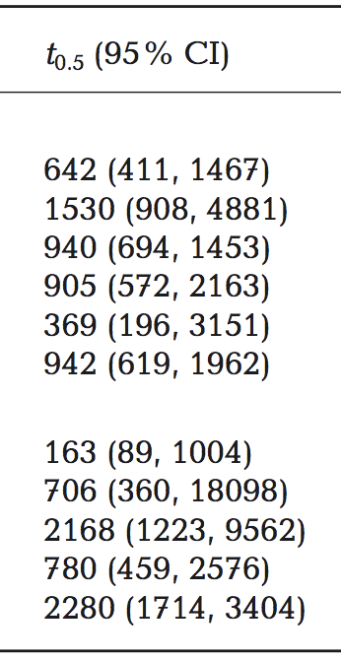
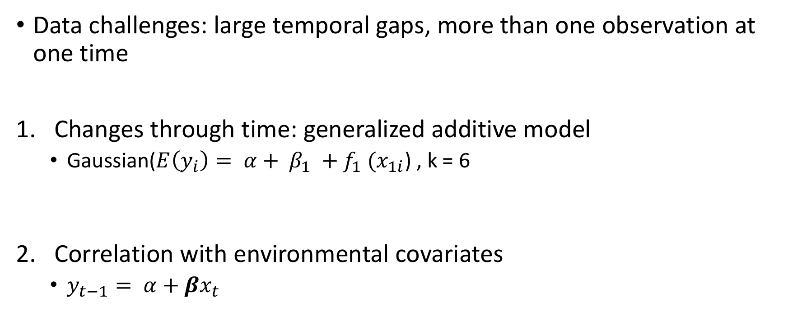
Modelling food web assimilated resources through time, with the environment
Data challenges: large temporal gaps, more than one observation at one time
Changes through time: generalized additive model
Gaussian($E\left(y_{i}\right)= α+ β_{1} {+ f}_{1}(x_{1i}$) , k = 6
Correlation with environmental covariates
$y_{t−1}= α+βx_{t}$

Slide 55
Discharge
Columbia River
Kuskokwim
Seward Line
Sea Surface Temperature
Mean Summer (GoA, EBS, WA)
Climate Regime
Pacific Decadal Oscillation (PDO)
North Pacific Gyre Oscillation (NPGO)
Multivariate ENSO Index (MEI)
Upwelling
Coastal Upwelling (Spring, Summer)
Average winter (Oct-Apr) along-shelf and cross shelf wind vector
NO₃⁻

Slide 56
1. δ¹³C decreases during recent decades in most regions

Slide 57
1. δ¹⁵N_{Phe} is variable but relatively stable through time across regions

Slide 58
Ice associated Algae
Dissolved Nitrate
C4 Plants
C3 Plants

Slide 59
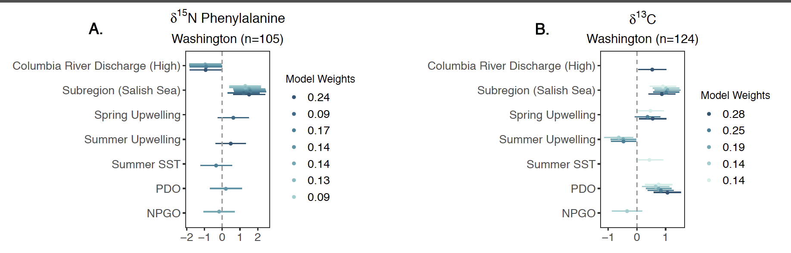
Time series covariates
delAIC < 2
Covariate Values

Slide 60
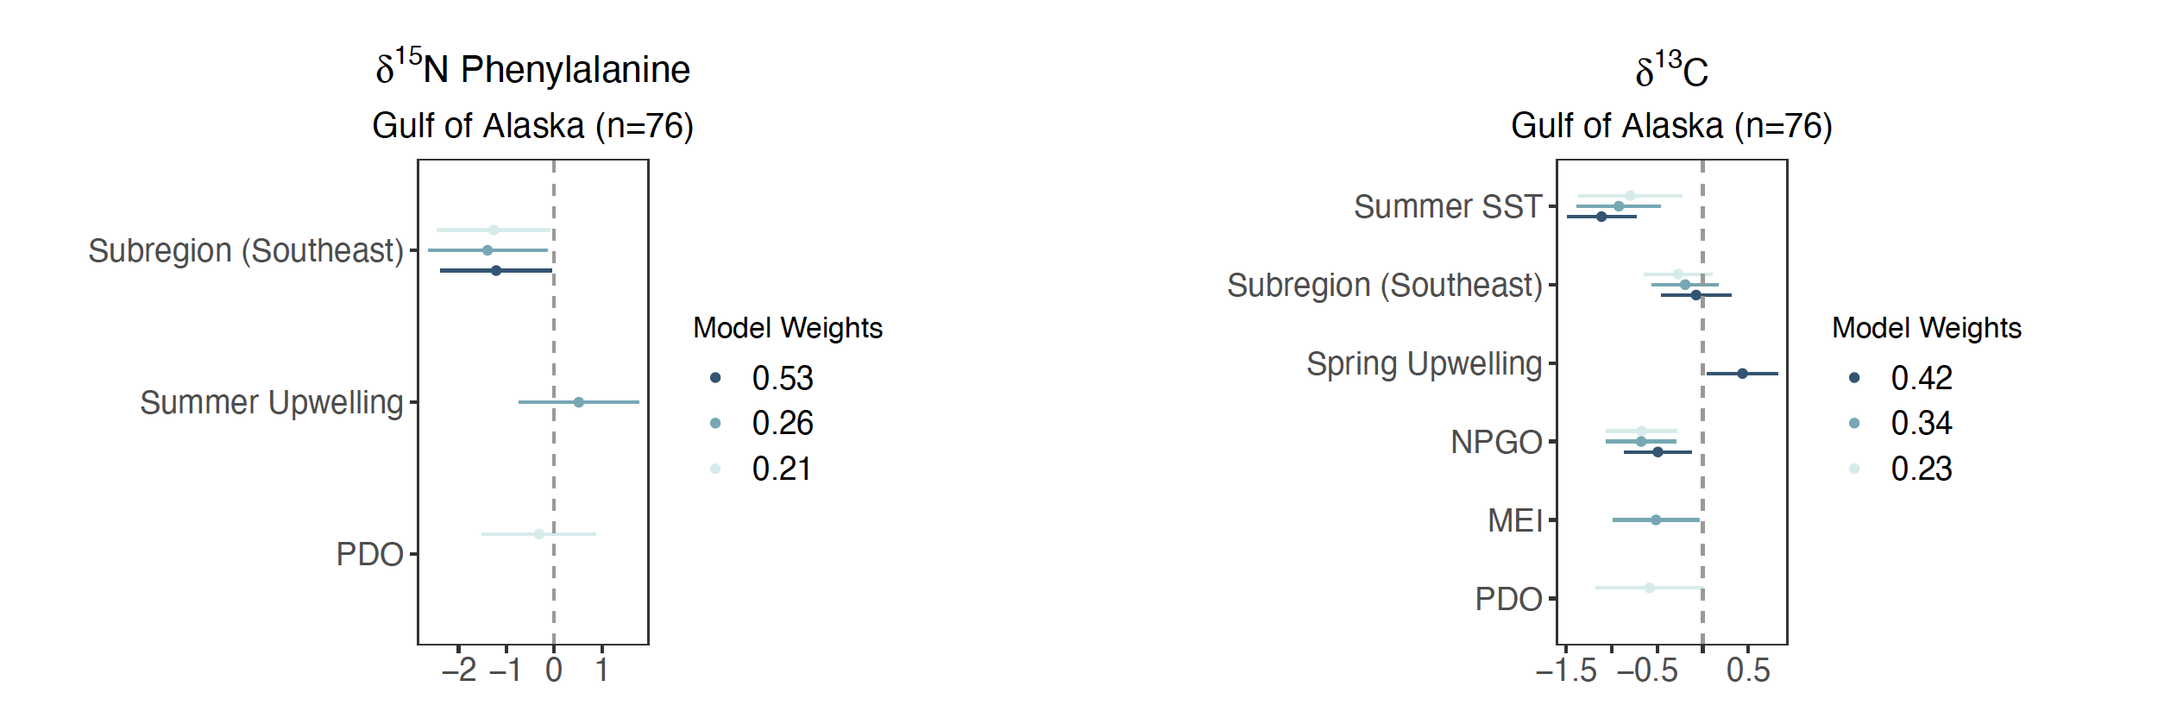
GULF OF ALASKA

Slide 61
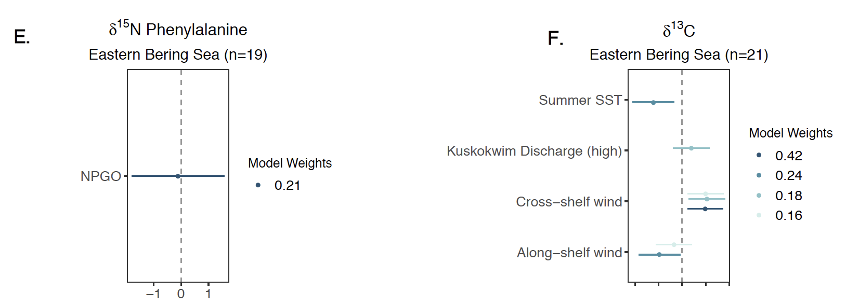
EASTERN BERING SEA

Slide 62
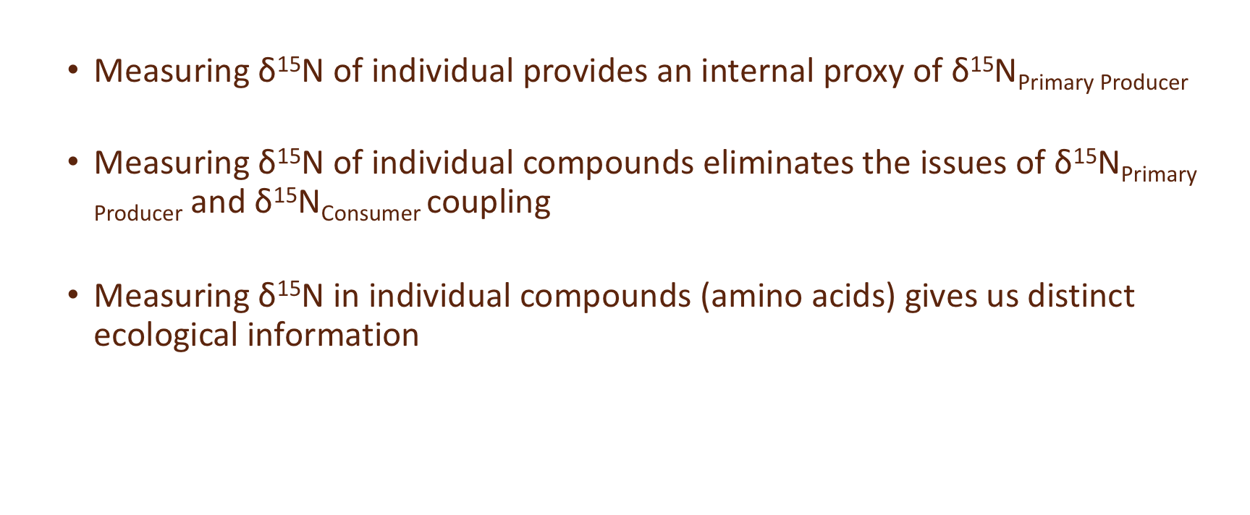
In Summary
Measuring $\text{δ}\text{15}\text{N}$ of individual provides an internal proxy of $\text{δ}\text{15}\text{N}\text{Primary} \text{Producer}$
Measuring $\text{δ}\text{15}\text{N}$ of individual compounds eliminates the issues of $\text{δ}\text{15}\text{N}\text{Primary} \text{Producer}$and $\text{δ}\text{15}\text{N}\text{Consumer}$ coupling
Measuring $\text{δ}\text{15}\text{N}$ in individual compounds (amino acids) gives us distinct ecological information

Slide 63
Sex specific foraging patterns are not a long-term phenomenon

Slide 64
Variation in bottom up control of food web assimilated productivity by nitrogen resources
More Productive
Phytoplankton dynamics change
Less Productive
N Resources Change

Slide 65
How does the environment impact resource utilization by coastal marine food webs?

Slide 66
How does the environment impact resource utilization by coastal marine food webs?

